Slide 1
ThreatIQ
Identify and remediate Threats across multicloud Networks
ACE Solutions Architecture Team

Slide 2
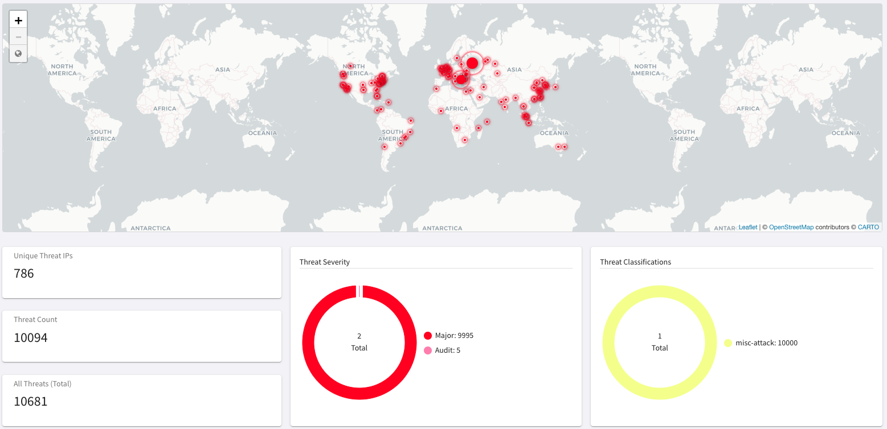
Problem Statement
Internet is filled with Bad reputation IP addresses
As soon as the public facing EC2/VM is powered ON, it is under attack
Customer Demands/Requirements
Multicloud native network security to dynamically identify, alert, and remediate potential threats to known malicious IP addresses
Distributed threat visibility and control built into the network data-plane at every hop
No data-plane performance impact

Slide 3
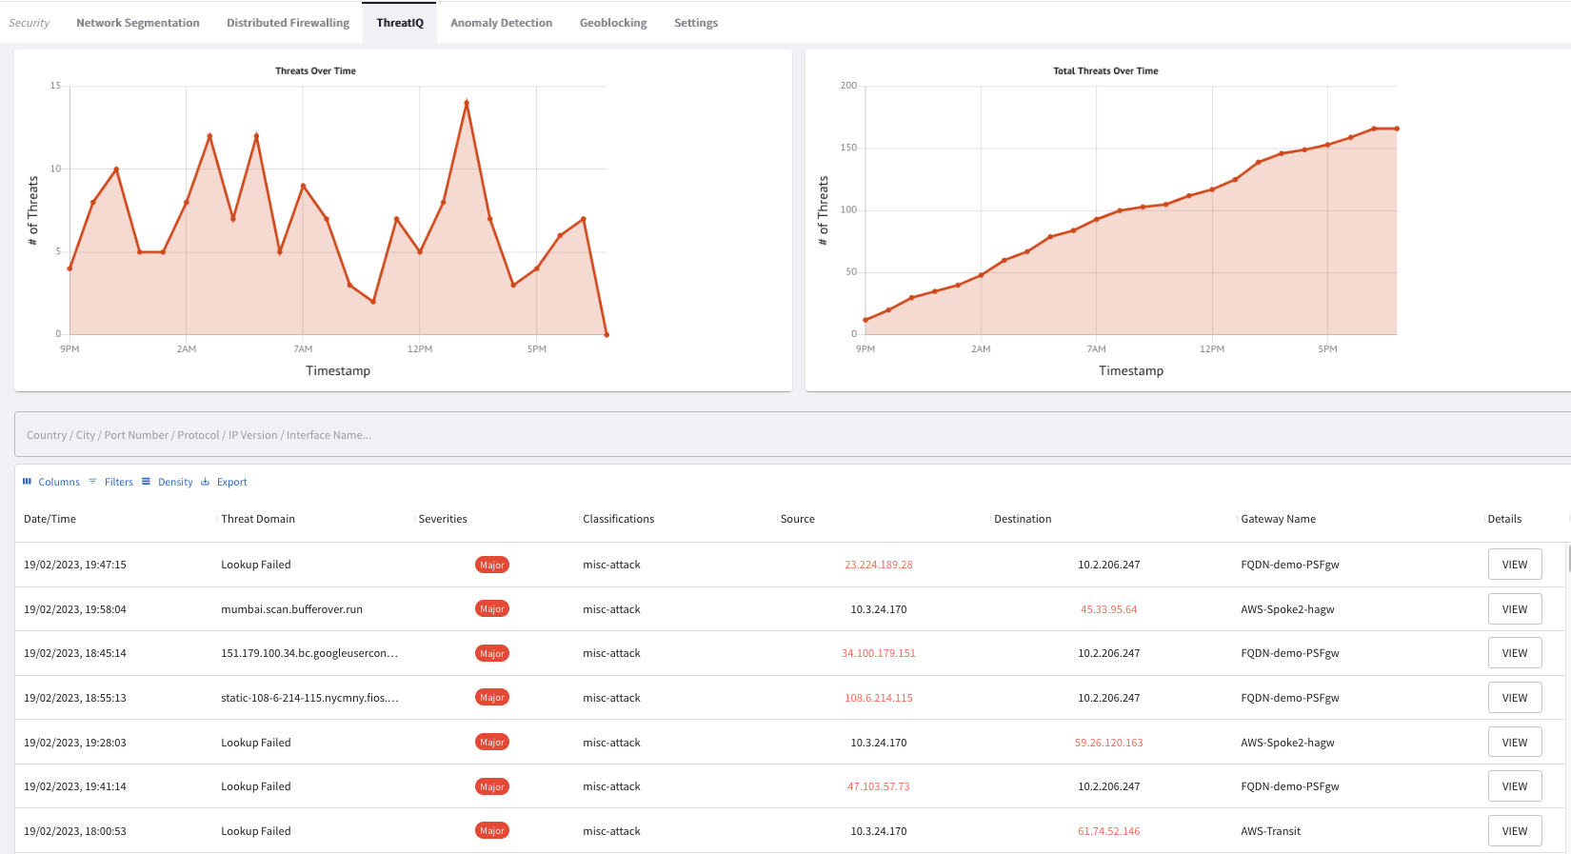
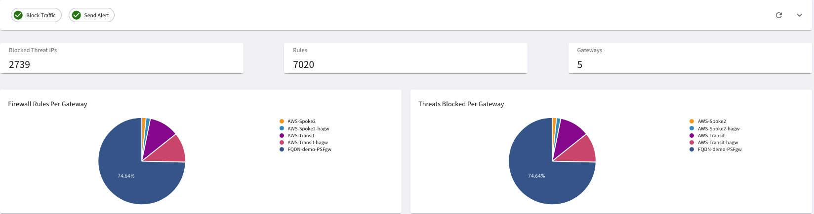
How does it work?
Distributed Inspection & Notification
Aviatrix gateways across Multicloud environment send real-time NetFlow data to CoPilot
CoPilot analyzes the data on all public destinations against well-known Threat DB.
CoPilot alerts on any potential threats in the environment
CoPilot provides extreme visibility of the impacted communication flow
Distributed Enforcement
CoPilot informs Aviatrix Controller to push firewall policies to all the Aviatrix gateways in the data path
Firewall policies automatically get updated with the current status of the threat.
Blocking threats with firewall policy is optional but recommended
ALERT

Slide 4
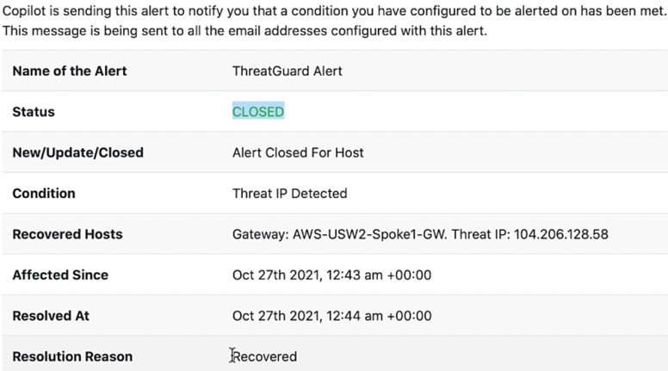
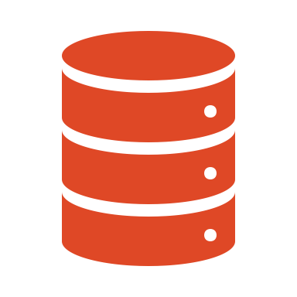




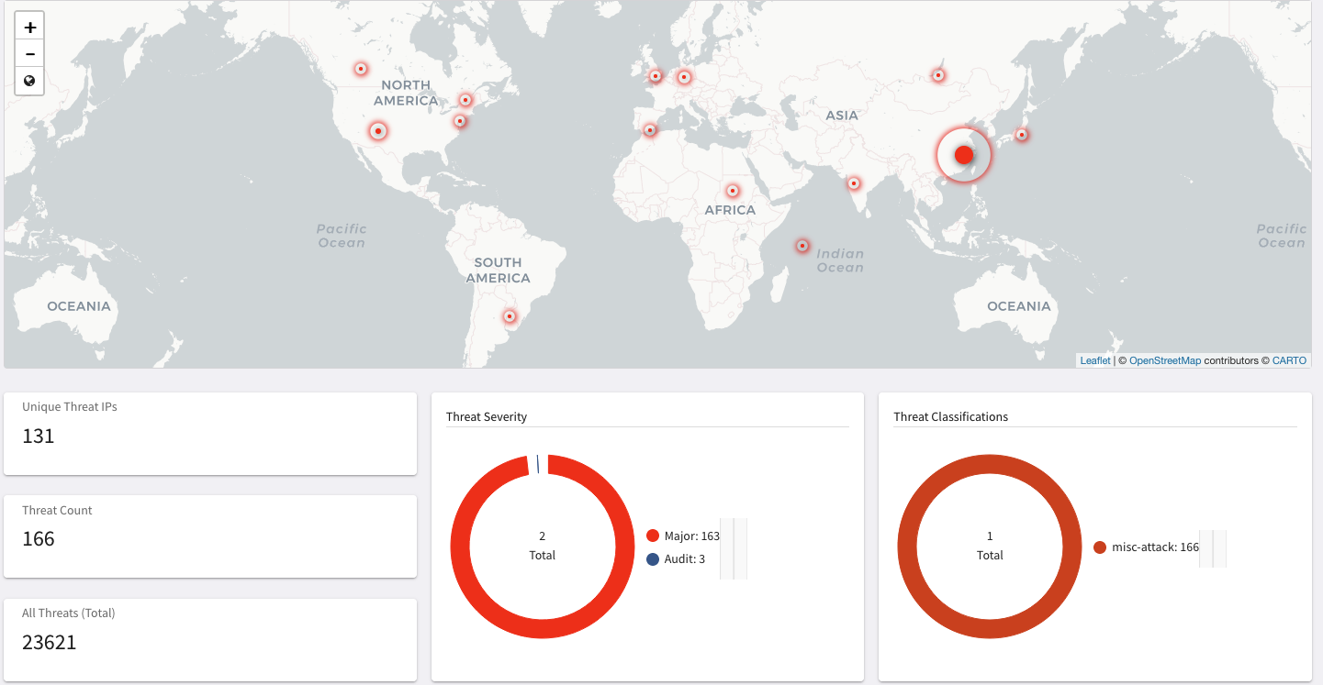
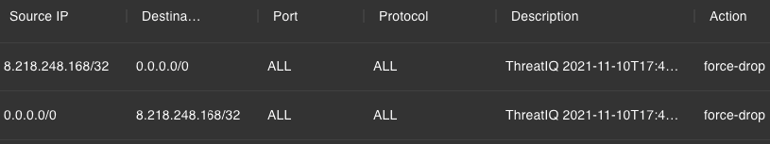



Workflow
4
ALERT
Aviatrix
Controller
Aviatrix
CoPilot
2
Threat DB
ANALYZE
ALERT
5
REMEDIATE
3
VISUALIZE
ALERT
1
DISCOVER
Firewall Rules
Visibility across entire multi-cloud network

Slide 5
CostIQ
Monitoring the cost of your business units
ACE Solutions Architecture Team

Slide 6
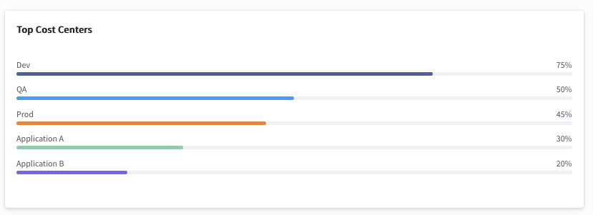
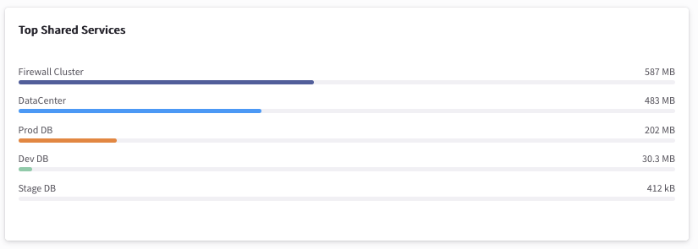
What is it?
The CostIQ feature provides detailed traffic distribution analysis for your cost centers, including traffic flowing to shared-service resource hosts by Cloud Account, by Cost Center, by VPC/VNet, and by Gateway.
The cost information displayed in CostIQ is grouped by:
Cost Center - A group of resources categorized by CSP (Cloud Service Provider) tags, associated VPCs/VNets. These CoPilot Cost Centers contain resources used by your real-life cost centers or business units.
Shared Service - A cloud or network resource shared by multiple teams or cost centers. You define Shared Services by listing the IP addresses or IP CIDR ranges of the shared resource hosts.

Slide 7
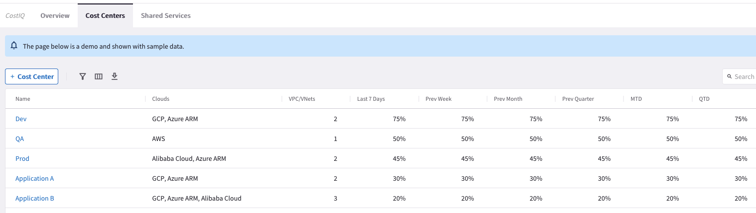
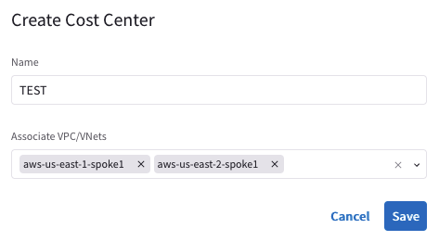
Cost Center (part.1)
The Cost Center is a logical grouping that represents a Line of Business or a department. Essentially, the Cost Center can embrace multiple VPCs/VNets across multiple clouds and multiple accounts.

Slide 8
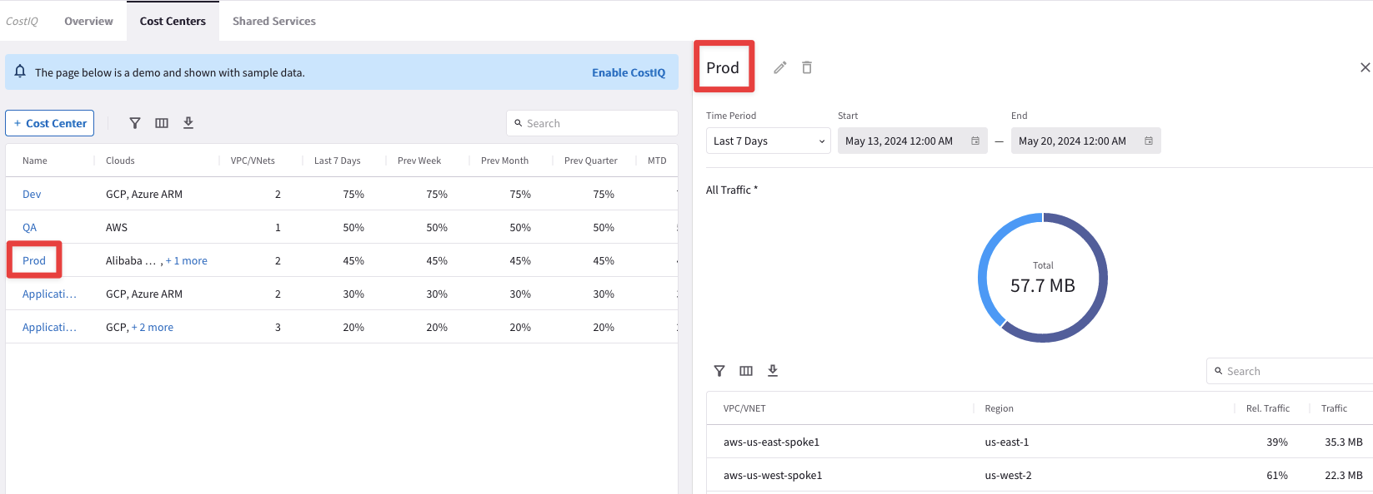
Cost Center (part.2)
After defined a Cost Center, you can investigate all the associated Application VPCs/VNets that are all part of that Cost Center. You can drill down and find out the relative amount of traffic for each Application VPC/Vnet.

Slide 9
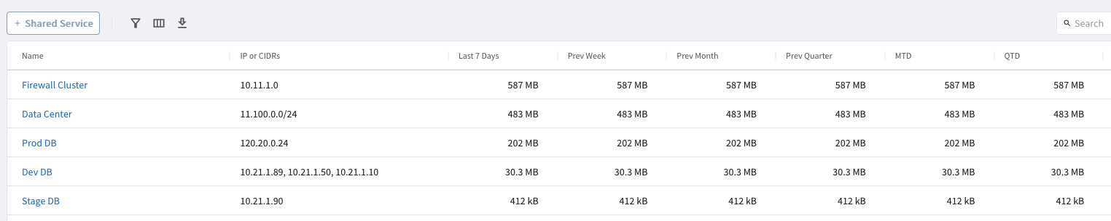
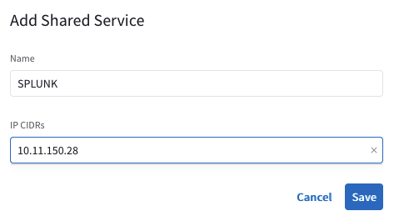
Shared Center (part.1)
The Shared Service is another logical grouping that represents a Shared Application, for instance a syslog collector like Splunk. You can also associate S3 buckets to your Shared Services.
The Shared Service allows you to monitor the resources that try reaching your shared applications

Slide 10
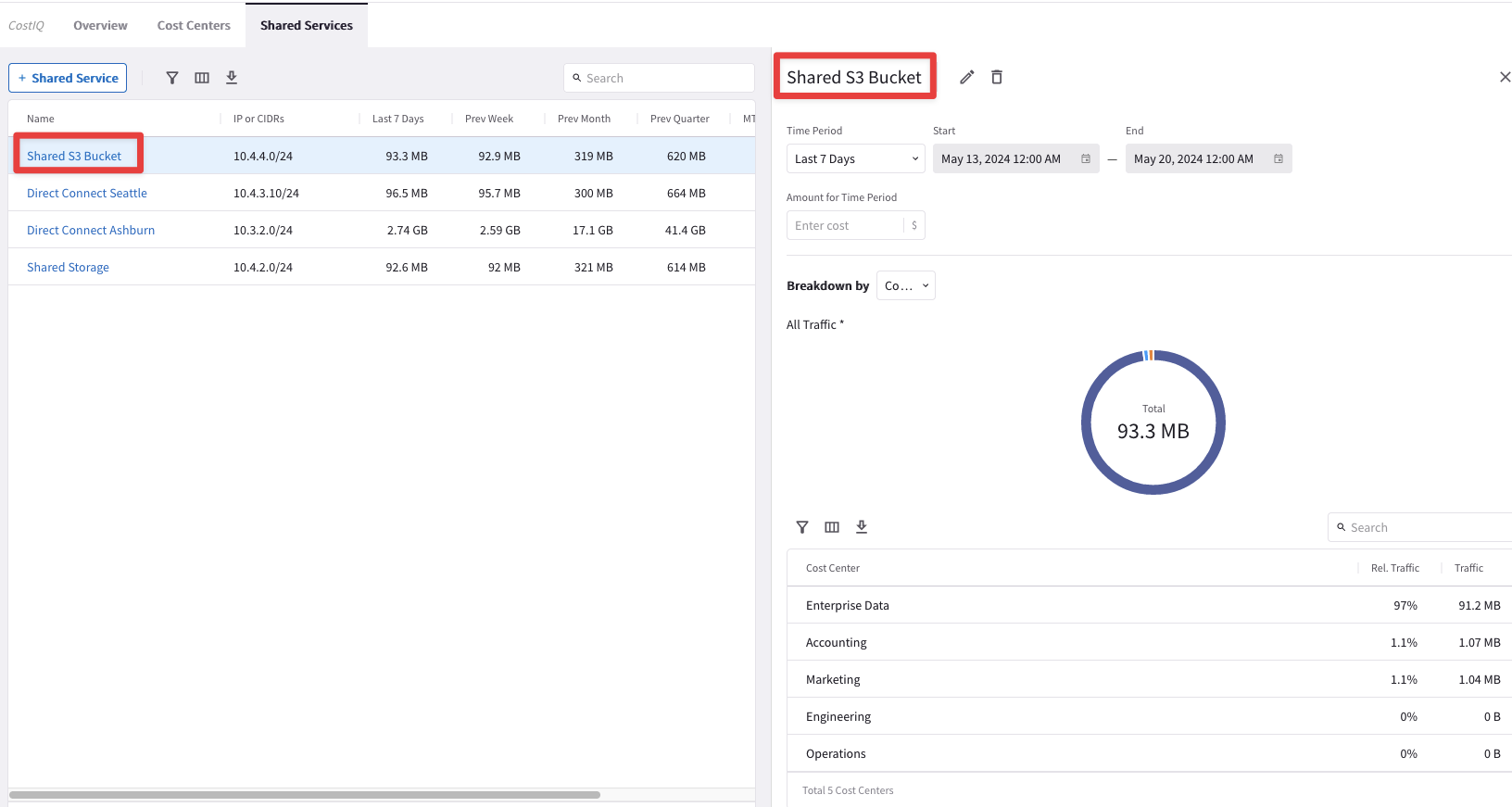
Shared Center (part.2)
After defining a Shared Service, you can accurately find out what LOB/Department has been utilizing it.

Slide 11
Next: Lab 9 – ThreatIQ and CostIQ

Slide 12





Why should enterprises care about it?
Internet access is everywhere in the cloud and on by default for some CSPs
Funneling traffic through choke points or 3rd party services is inefficient and ineffective
Protect business from security risks associated with:
Data exfiltration
Botnets
Compromised hosts
Crypto mining
TOR
DDoS, and more
Workloads
Workloads

